Slide 1
Waterfall Model
Speaker: Li-Wen Chen
Adviser: Quincy Wu
Date: 2010-03-10

Slide 2
Outline
Waterfall Model
Advantage
Disadvantage
Conclusion
Reference

Slide 3
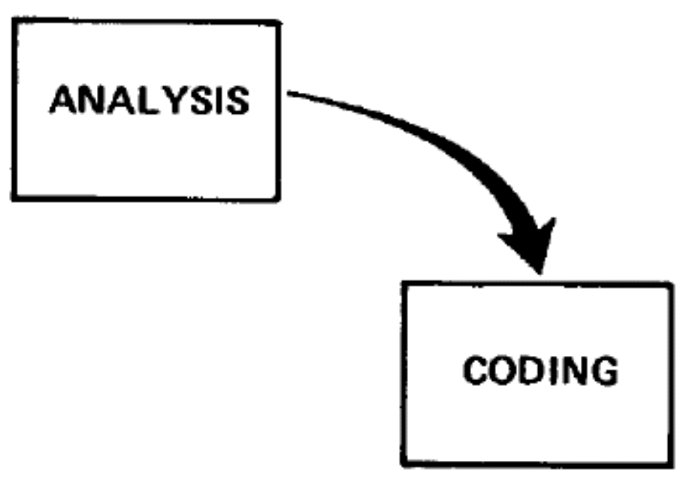

Slide 4
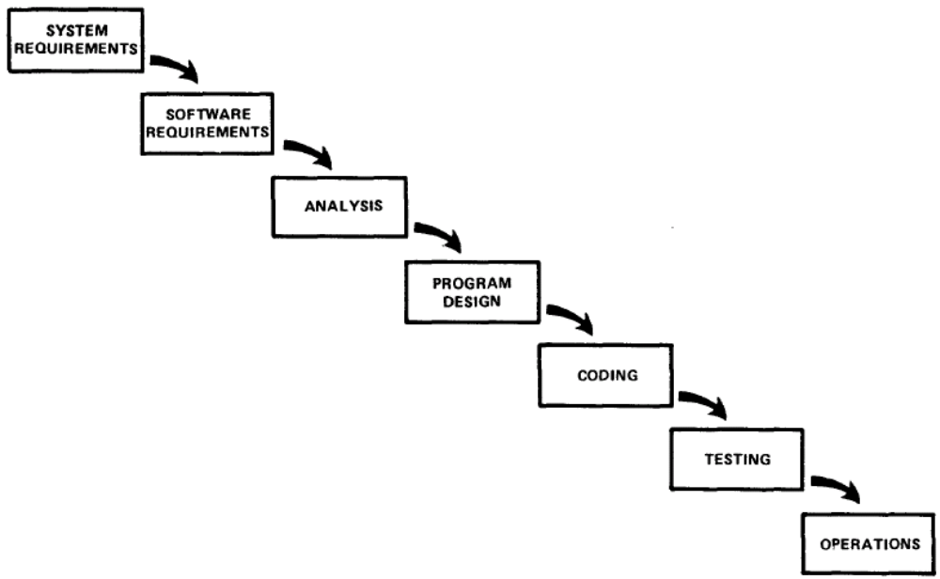

Slide 5
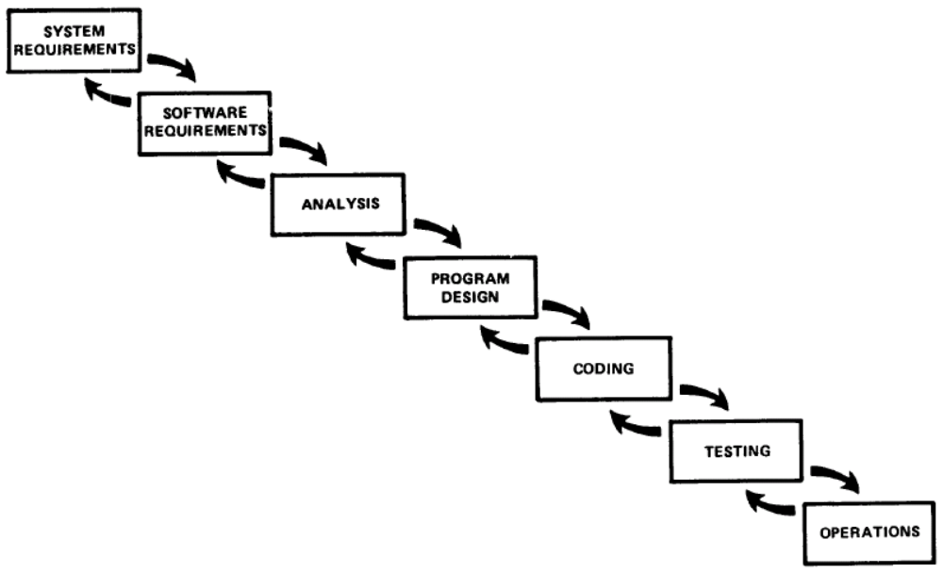

Slide 6
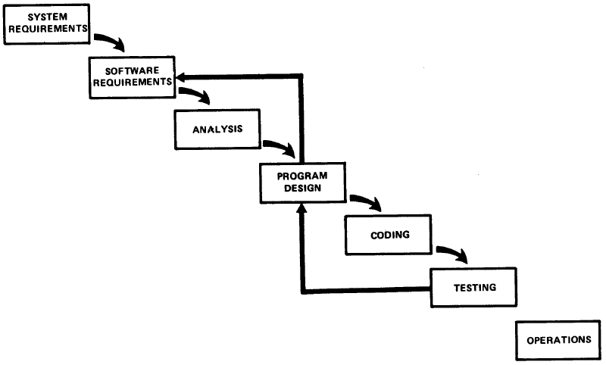

Slide 7
Five additional features that must be added to this basic approach to eliminate most of the development risks.
  STEP 1: Program design comes first
  STEP 2: Document the design
  STEP 3: Do it twice
  STEP 4: Plan, control and monitor testing
  STEP 5: Involve the customer

Slide 8
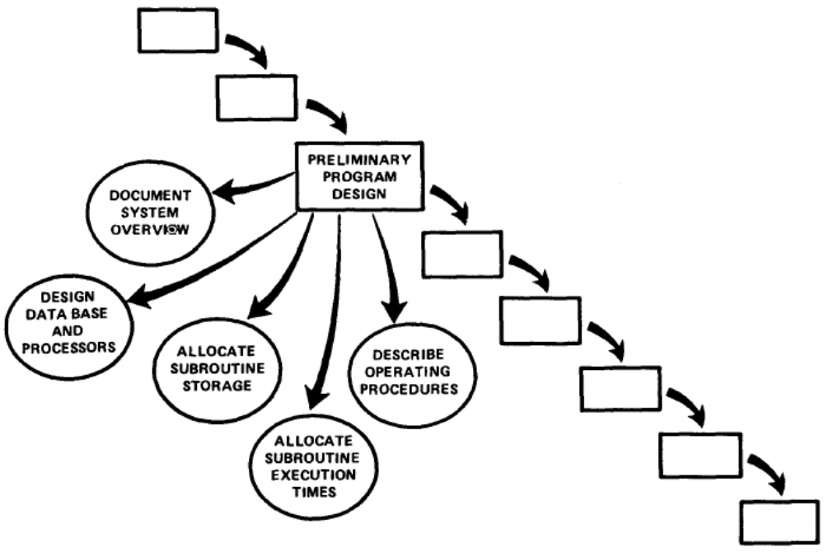
STEP 1: Program design comes first

Slide 9
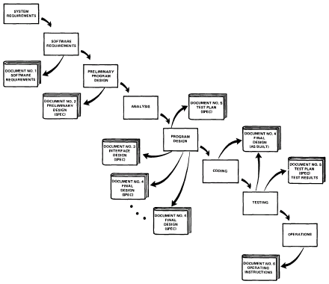
STEP 2: Document the design

Slide 10
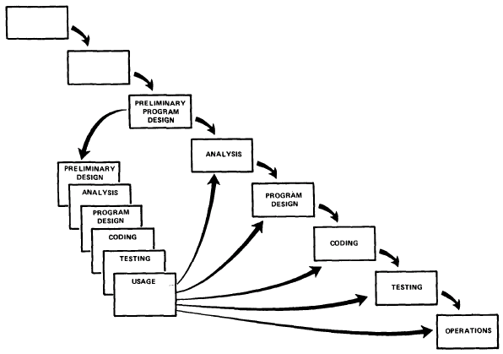
STEP 3: Do it twice

Slide 11
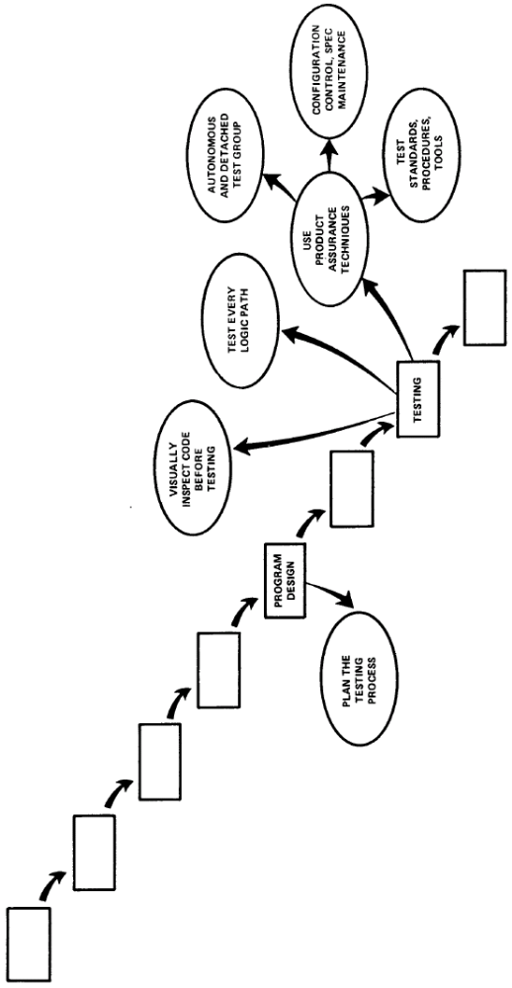
  STEP 4: Plan, control and monitor testing

Slide 12
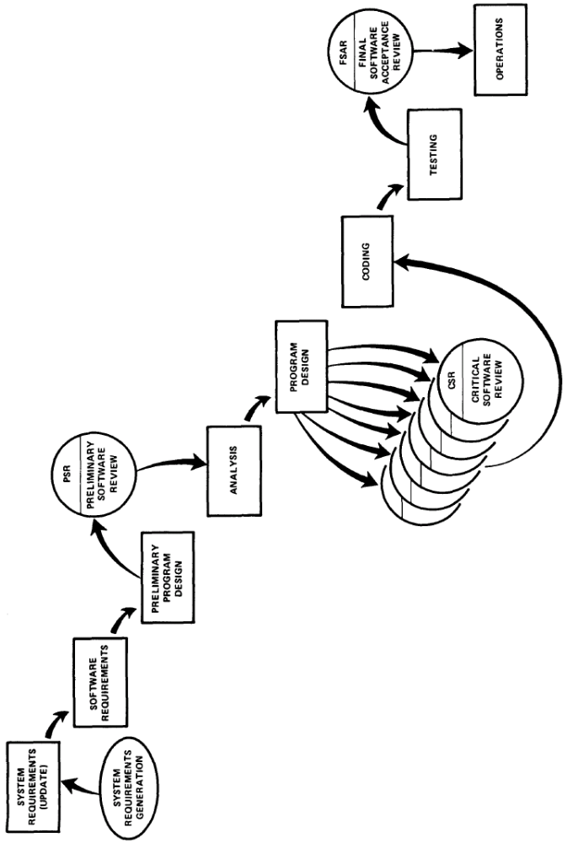
  STEP 5: Involve the customer

Slide 13
Six Distinct Phases
development proceeds sequentially through a series of phases
  Requirements analysis
  Design
  Implementation
  Testing
  Installation
  Maintenance

Slide 14
Advantage
progress can be conclusively identified (through the use of milestones) by both vendor and client
ensures minimal wastage of time and effort
reduces the risk of schedule slippage, or of customer expectations not being met

Slide 15
Disadvantage
It does not allow for much reflection or revision.
Estimating time and costs with any degree of accuracy (as the model suggests) is often extremely difficult.
  customers don't really know what they want up-front
Designs that look feasible on paper turn out to be expensive or difficult in practice.
  re-design destroys the clear distinctions between phases of the traditional waterfall model
  a clear division of labor between, say, "designers", "programmers" and "testers“ is neither realistic nor efficient in most software firms

Slide 16
Waterfall development model considered harmful
In the early days of simple, stand-alone applications, the waterfall model worked well spawning a host of voluminous methodologies, but it does not suit the problems of the complex, risky, and integrated projects that IT has to deliver today.
Most of today's projects have a high proportion of reuse. The waterfall idea of creating a detailed set of requirements and then trying to find a package that fits is neither economic not practical.

Slide 17
Conclusion
Whether you should use it or not depends largely on
  how well you believe you understand your customer's needs
  how much volatility you expect in those needs as the project progresses
The model is recommended for use only in projects which are relatively stable and where customer needs can be clearly identified at an early stage.

Slide 18
Reference
Waterfall Model
Managing the Development of Large Software Systems.
Waterfall model considered harmful
Understanding the pros and cons of the Waterfall Model of software development

